Slide 1

TextVerify: A Better AI Detection Model
Dev Bhatia
Computer Systems Lab Dr. Yilmaz
Period: 3
Date: 5/21/2025
TextVerify

Slide 2
Problem
AI used very prominently
People tend to paraphrase AI content
Difficulty telling original work from AI generated text
Current AI detectors don’t work well
Leads to lack of knowledge for students
AI gives untrustworthy or false information
Need better detection mechanism

Slide 3
Background
Many AI detectors out there
Accuracy varies significantly
Unreliable for teacher use
Possibility of false positives
Not close to 100% accuracy

Slide 4
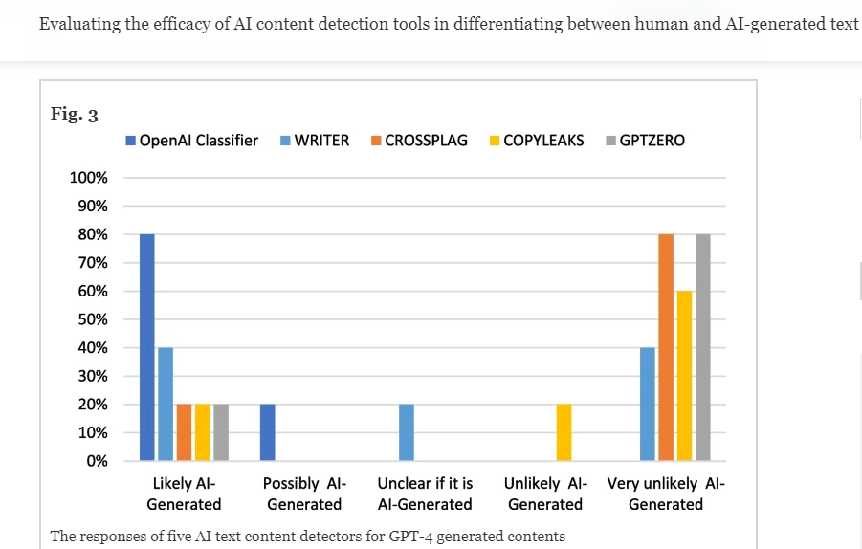
Other Solutions
Most prominent AI detectors:
GPTZero [6]
Copyleaks [7]
CrossPlag [8]
Detectors do not perform well against GPT 4 and other AIs
Many false negatives

Slide 5
Other Solutions Continued
How these AI detectors work
GPTZero:
Amount of predictability in the text
Looks at the variance in the sentences, AI generated text typically has less variety and is more predictable.
Copyleaks
Scans the document against different sources
Sentence by sentence detection using writing patterns
CrossPlag
Text analysis using Natural Language Processing
Compares to a dataset created by human and AI content
Pros: Detect well on older GPT generations
Cons: Fail on GPT 4 and paraphrased AI generations, inconsistencies

Slide 6
Demo of Current Solutions
GPTZero:
CopyLeaks: (doesn't seem to work without subscription)
CrossPlag:
Sample AI generated text: “Playing basketball is always exciting. The moment I step onto the court, I feel the energy rise. The sound of the ball bouncing and sneakers squeaking on the floor makes me focus on the game. I enjoy dribbling the ball, passing to my teammates, and shooting for the basket. Each time the ball goes in, it’s a rush of excitement. Working with the team, moving fast, and thinking on my feet keeps me engaged. Basketball is not just a sport to me, it’s a fun way to stay active and connect with others.”

Slide 7
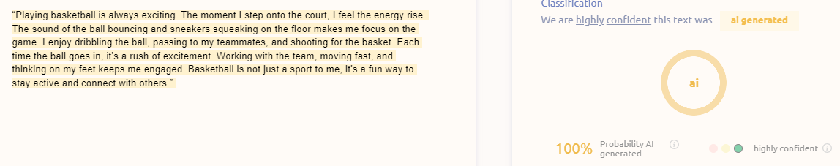
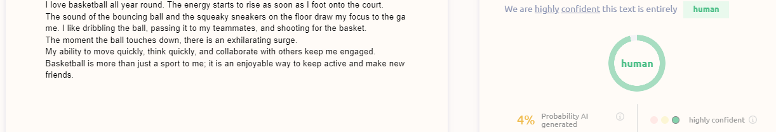
AI Detectors with Paraphrasing continued

Slide 8
Why Is Mine Better?
TextVerify is more accurate on GPT 4
Current detectors struggle on this
TextVerify is better with paraphrased GPT 4
GPT 4 content that people paraphrase but the meaning is the same
TextVerify works better with DeepSeek, Copilot, Grok content

Slide 9
Novelty
Using retrieval methods (not used on common AI detectors)
Using a database of AI generations to tell whether text is AI generated
Use cosine similarity scores
Find any matches to AI generations in the database
Higher accuracy than current AI detecting algorithms have

Slide 10
Impact
Can be used by educators
A more reliable way to check AI content
Trustworthy source of AI detection
Maintains integrity
Creates a fair learning environment

Slide 11
Method
Given an input text and a question
Use a Doc2Vec encoder to encode input text
Store Doc2Vec encoded sequences of text that were generated by AI in database in a web server
Check to see if input text vector matches database text vector (cosine similarity)
Set the threshold (T), if the text score is higher than T, then it is judged as AI Generated
Output whether the text is detected as AI generated or not

Slide 12
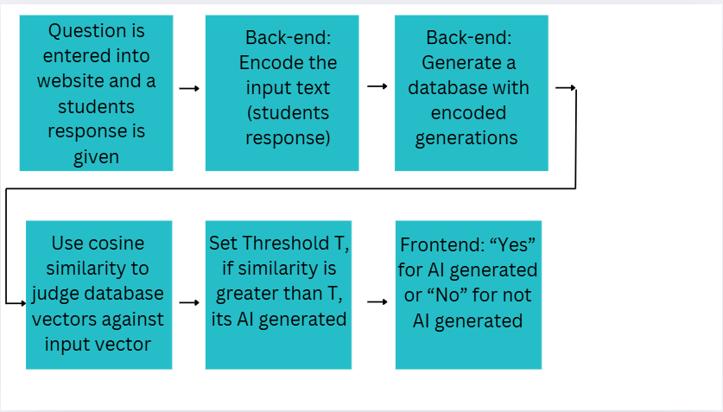
Method: Flow Diagram

Slide 13
Process Overview
Example:
Question (Entered by teacher): Describe the sky
Input Text (Sample response): "The sky is clear and blue"
Input Text Vector Representation: [0.5,0.3,0.7,0.1,0.4,0.2]
Database of generations:
“The sky is sunny and bright” Vector: [0.45,0.25,0.65,0.1,0.35,0.3]
“The sky has rain” Vector: [0.4,0.2,0.6,0.1,0.3,0.2]
“The sky is bright and blue” Vector: [0.51,0.31,0.69,0.12,0.41,0.22]
Cosine Similarity "The sky is clear and blue" and "The sky is bright and blue" = 0.80
Threshold = 0.60
0.80 > 0.60, therefore AI generated

Slide 14
Process Overview

Slide 15
Encoding - Doc2Vec - Overview
General Overview:
Learn a fixed-length vector representation for document texts.
Every document is assigned a unique vector (document vector). This vector is used along with local context words to help predict a target word in the document. Over time this forces the document vector to capture the semantics of the document.
The neural network is given a fixed window of words (ie: the correct answer) and has to learn a document vector that fits that window of words. It does this for the whole document and all the documents.
Uses a 2-layer neural network

Slide 16
Doc2Vec Continued
Purpose
Training the neural network.
Data is coming in the form of documents, these documents are given document vectors that are initially set to random and are updated while training, eventually representing the semantics of the document.

Slide 17
Doc2Vec Model Overview
Distributed Memory version of Paragraph Vector (PV-DM)
Input Layer:
Context words and a Document Vector
Originally the words and Document Vector are unique vectors (initialized randomly)
Hidden Layer:
Take the input vectors and average them.
Activation Function (ReLU)
Use the hidden layer representation to predict the target word
Output is a probability distribution over the vocabulary, which is optimized with softmax.
Train the network to maximize the probability of the correct (target) word given the combination of the document vector and surrounding context words.
Sliding window of words moves around the document

Slide 18
Doc2Vec for a given document
Sliding window of text goes through the document (ex: 10 word length text). Go window by window into the text and train the NN using that text window).
Example of a Document: [The American colonies declared independence from British rule in 1776.] [George Washington bravely led the Continental Army through fierce battles.] [Treaties and compromises eventually united the young nation after struggles.] [Rapid industrial growth later transformed America into modern global power.]
Ex: It goes 10 words at a time, the NN is training to guess the word in bold. The rest of the words in a text window and the document vector are used as inputs for the NN.

Slide 19
Explanation of the Model
Go over each document in the set of documents
Initialize the Document Vector to random
Go over each window of words (length = 10 words) in the document
Example window of words that goes into the Neural Network “The American colonies declared independence from British rule in 1776.”
Input
Document Vector
Rest of the context words
“The American colonies declared independence British rule in 1776” not including middle word “from”
Each word is translated into random word vectors
Concatenation/average
Average the word vectors and Document Vector (then apply ReLU)
Output is a probability distribution over the vocabulary, the word with the highest probability is chosen as the neural network’s predicted word.
This is then compared with the middle word.
Do backpropagation to minimize the error to the actual word

Slide 20
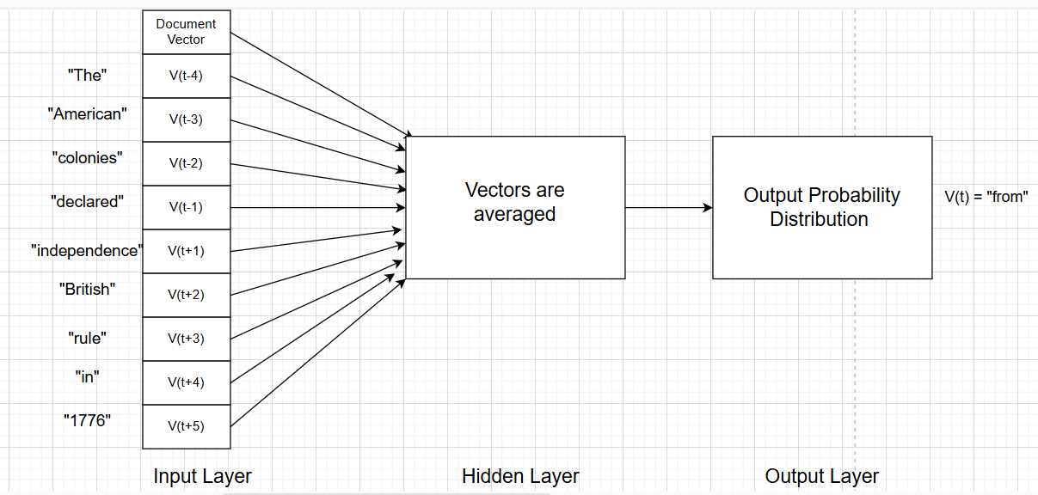
Model Diagram 1

Slide 21
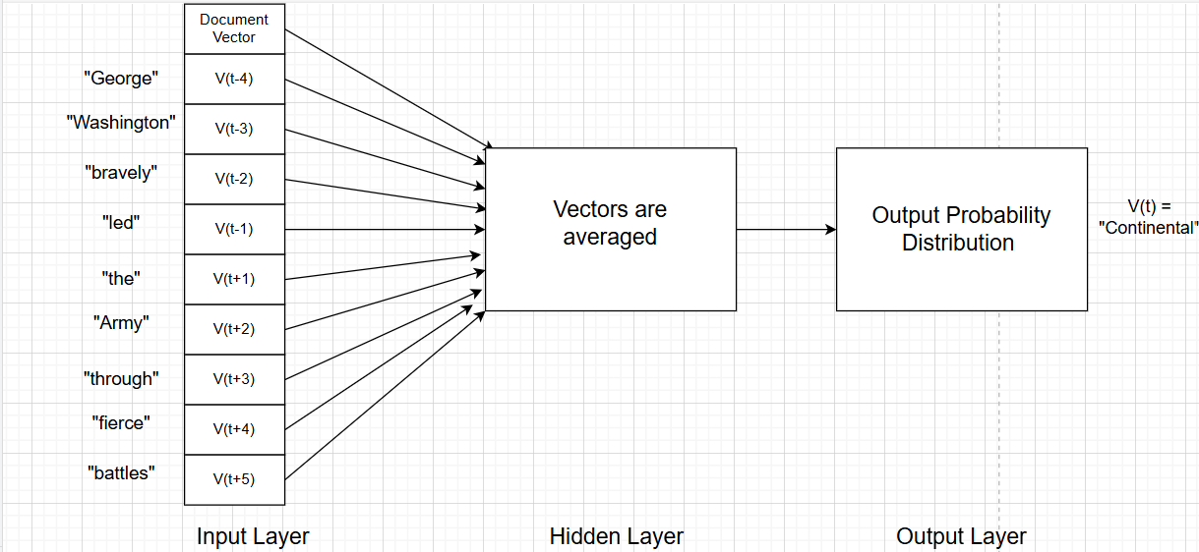
Model Diagram 2

Slide 22
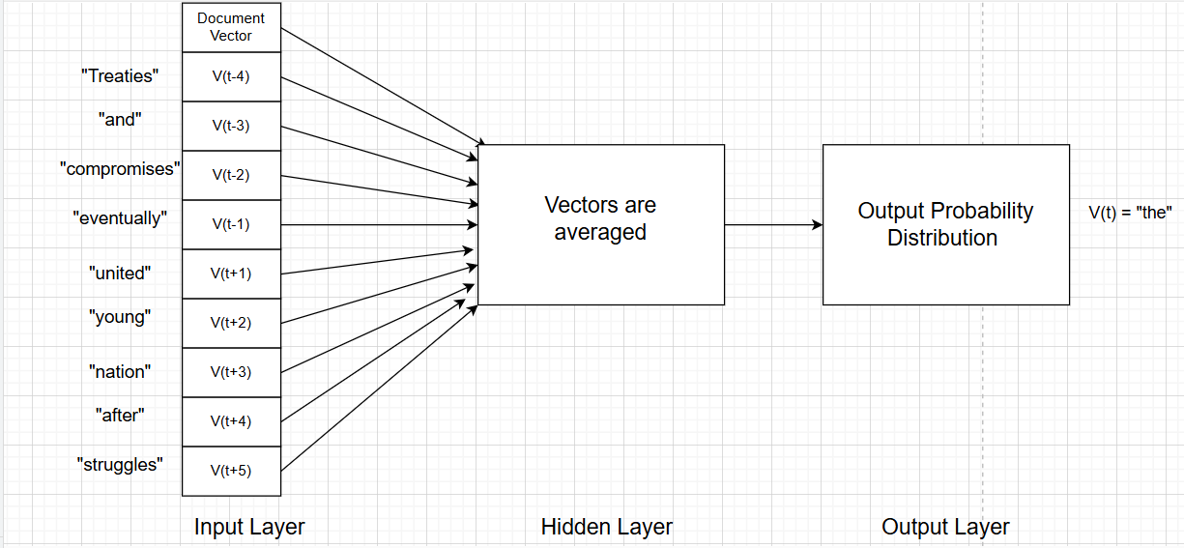
Model Diagram 3

Slide 23
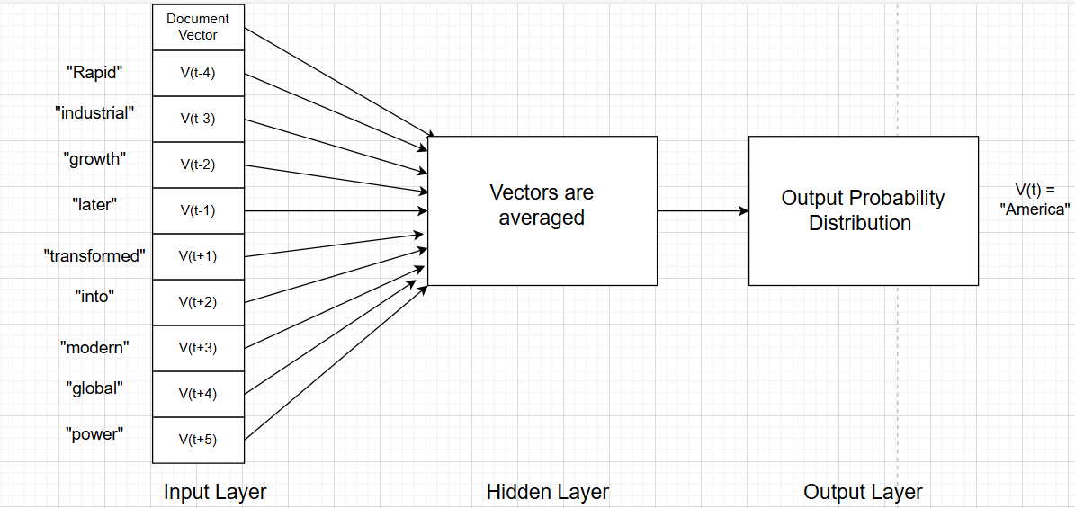
Model Diagram 4

Slide 24
Model in the Long Term
Over multiple training iterations, the model adjusts the word vectors and document vector to minimize the output prediction error (how far off the output is from the predicted middle word)
Using backpropagation and gradient descent
This makes the document vector align with the documents’ overall semantics
Documents that have similar ideas and topics will have overlapping sets of context words. During training, their document vectors will change to reflect the similarities in the documents.
The vectors for similar documents will converge toward similar areas in the vector space

Slide 25
Final Vector for a Document
[-0.4497235417366028, -1.1115018129348755, -0.42881670594215393, 0.13737916946411133, -0.3669651448726654, 0.34607723355293274, 0.30737361311912537, 0.7917163968086243, -1.1778119802474976, -0.3252505660057068, 0.7291356921195984, 0.5908859968185425, 0.1598273068666458, -0.09482122212648392, 0.15619386732578278, -0.08169367909431458, 0.08607824146747589, 0.7075214385986328, -1.770843744277954, -0.384193480014801, -0.17669035494327545, 0.811805009841919, 0.03435264527797699, 1.2345770597457886, 0.6618621945381165]

Slide 26
Database
Created using AI generated text that answers the teachers question
The text is generated using Chat GPT 4o mini’s API
That text is then encoded with Doc2Vec
Then that vector is stored in the database

Slide 27
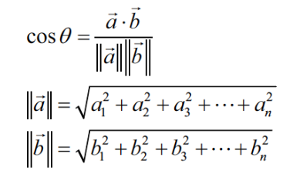
Cosine Similarity
Used to compare how similar two Doc2Vec encoded vectors are (comparing students input vector to the closest database vector)
Gives a value in the range 0 to 1
Close to 1 means the generations are similar
Close to 0 means the generations are not similar
Example:
Document 1: [1, 1, 1, 1, 1, 0]
Let’s refer to this as A
Document 2: [1, 1, 1, 1, 0, 1]
Let’s refer to this as B
Cosine Similarity (A, B) = (4) / (2.2360679775*2.2360679775) = 0.80 (80 percent similarity between the two documents)

Slide 28
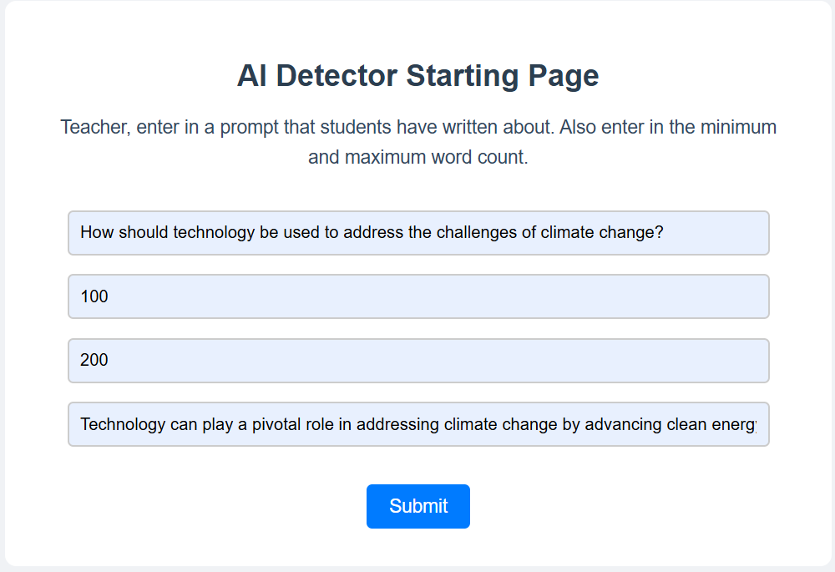
Demo

Slide 29
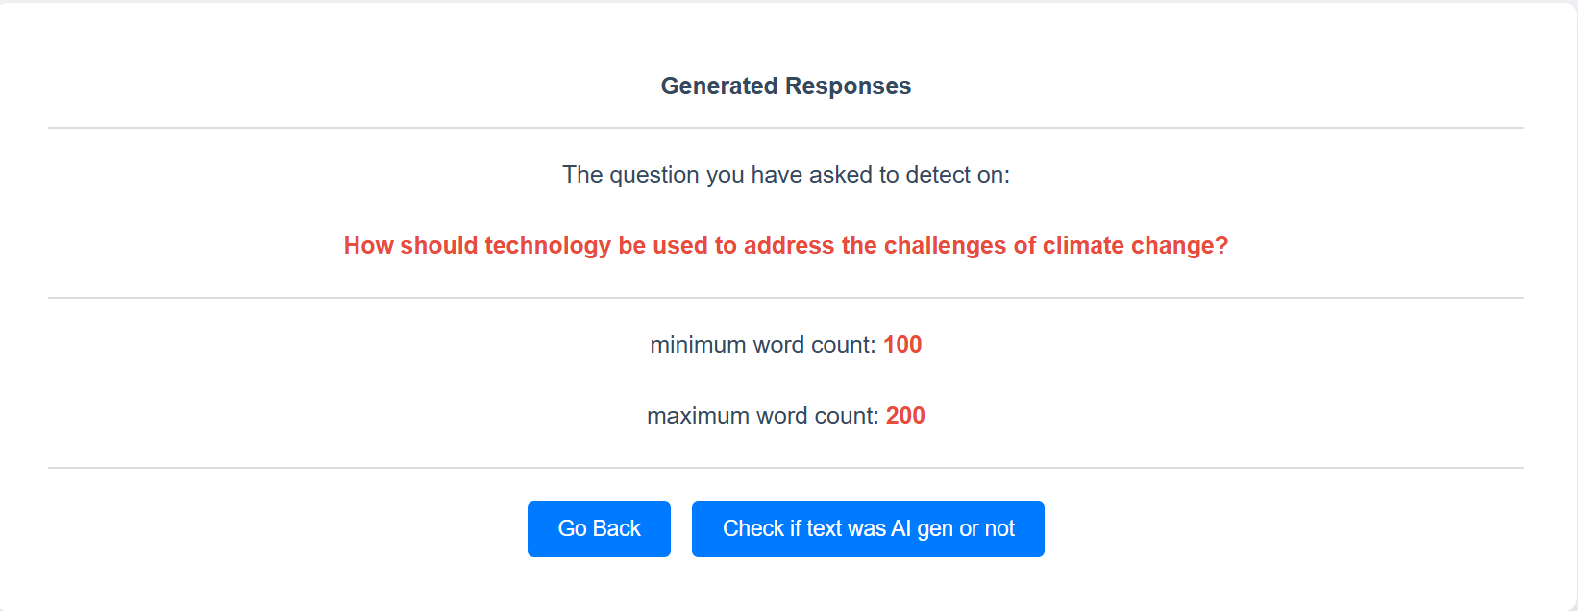
Demo Continued

Slide 30
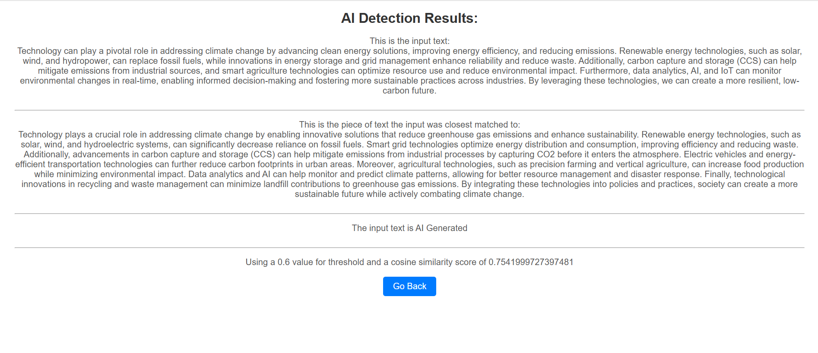
Demo Continued

Slide 31
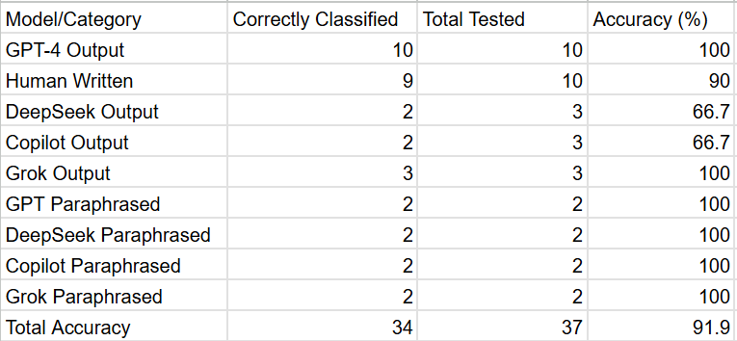
Results
91.9% accuracy on detecting text generated by AI
TextVerify takes input text
Could be paraphrased
Could be from any AI
Tells whether it was AI generated or not
Got better performance than current AI detectors

Slide 32
Limitations
Text not generated by students
Text with shorter number of words
Not using watermarking and statistical outlier methods
Text written in other languages

Slide 33
Future Work
Improvements in text generated for other things besides school
Using retrieval methods along with other methods (watermarking, statistical outlier) to improve shorter text classification
Using retrieval methods with AI generations in other languages

Slide 34
Conclusion
I solved the problem of AI Detection using Retrieval Methods

Slide 35
References
[1]A. M. Elkhatat, K. Elsaid, and S. Al-Meer, “Evaluating the efficacy of AI content detection tools in differentiating between human and AI-generated text,” International journal for educational integrity, vol. 19, no. 1, Sep. 2023, doi: https://doi.org/10.1007/s40979-023-00140-5
[2]A. Singh, “A Comparison Study on AI Language Detector,” IEEE Xplore, Mar. 2023, doi: https://doi.org/10.1109/ccwc57344.2023.10099219
[3]M. Perkins et al., “Simple techniques to bypass GenAI text detectors: implications for inclusive education,” International Journal of Educational Technology in Higher Education, vol. 21, no. 1, Sep. 2024, doi: https://doi.org/10.1186/s41239-024-00487-w
[4]K. Krishna, Y. Song, M. Karpinska, J. Wieting, and M. Iyyer, “Paraphrasing evades detectors of AI-generated text, but retrieval is an effective defense Mohit Iyyer,” Oct. 2023, doi: https://doi.org/10.48550/arXiv.2303.13408
[5]D. Dukić, D. Keča, and D. Stipić, “Are You Human? Detecting Bots on Twitter Using BERT,” IEEE Xplore, Oct. 01, 2020. doi: https://doi.org/10.1109/DSAA49011.2020.00089. Available: https://ieeexplore.ieee.org/document/9260074
[6]G. Shperber, “A gentle introduction to Doc2Vec,” Medium, Nov. 05, 2019. Available: https://medium.com/wisio/a-gentle-introduction-to-doc2vec-db3e8c0cce5e
[7]A. Prakash, “Understanding Cosine Similarity: A key concept in data science,” Medium, Sep. 21, 2023. Available: https://medium.com/@arjunprakash027/understanding-cosine-similarity-a-key-concept-in-data-science-72a0fcc57599
[8]“OpenAI Platform,” Openai.com, 2025. Available: https://platform.openai.com/docs/quickstart?api-mode=chat
[9]E. Tian, “GPTZero,” gptzero.me, 2022. Available: https://gptzero.me/
[10]“Copyleaks: AI & Machine Learning Powered Plagiarism Checker,” copyleaks.com. Available: https://copyleaks.com/
[11]“Crossplag,” app.crossplag.com. Available: https://app.crossplag.com/individual/detector
[12]V. Chen, “How Do AI Detectors Work? | GPTZero,” AI Detection Resources | GPTZero, Oct. 14, 2024. Available: https://gptzero.me/news/how-ai-detectors-work/
[13]“AI Content Detector FAQs How It Works Understanding the Results Detection Capabilities & Limitations.” Available: https://copyleaks.com/wp-content/uploads/2023/05/ai-content-detector-faqs.pdf
[14]Agnesa Nuha, “Detecting if a text is AI generated - Crossplag,” Crossplag, Dec. 19, 2022. Available: https://crossplag.com/detecting-if-a-text-is-ai-generated/. [Accessed: Apr. 24, 2025]

Slide 36
Q&A

Slide 37
THANKS!

